Slide 1
GEO THE HUNTER

Slide 2
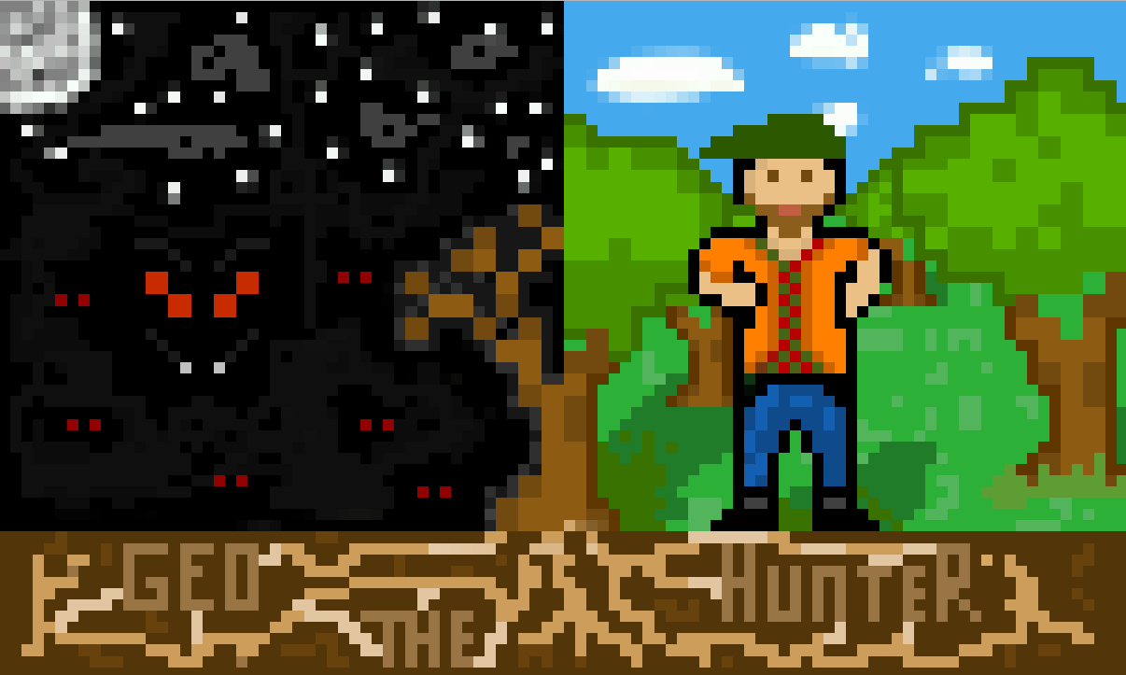

Slide 3
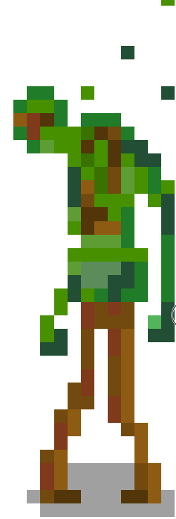
Spiritus silvarum
Slow but extremely strong
Made from the forest he protects

Slide 4
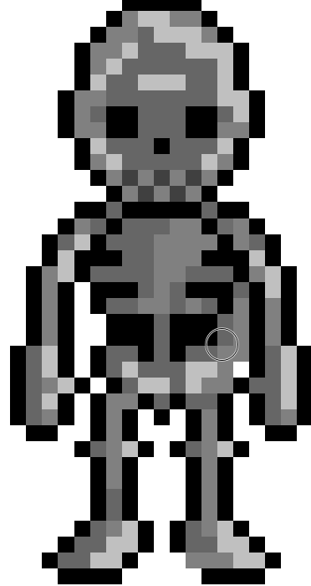
Skeleton
Small, quick and easily missed

Slide 5
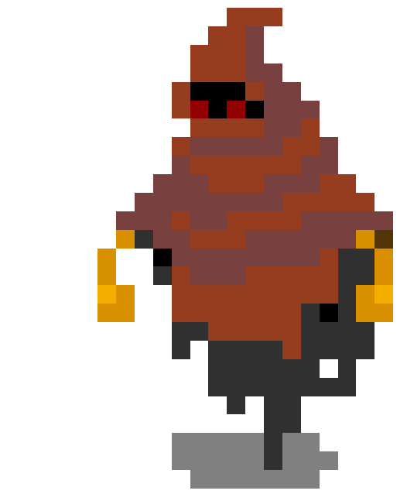
Autumn shadow’s

